Slide 1
Confidence Intervals Confidence Intervals for the Mean
www.Stats-Lab.com

Slide 2
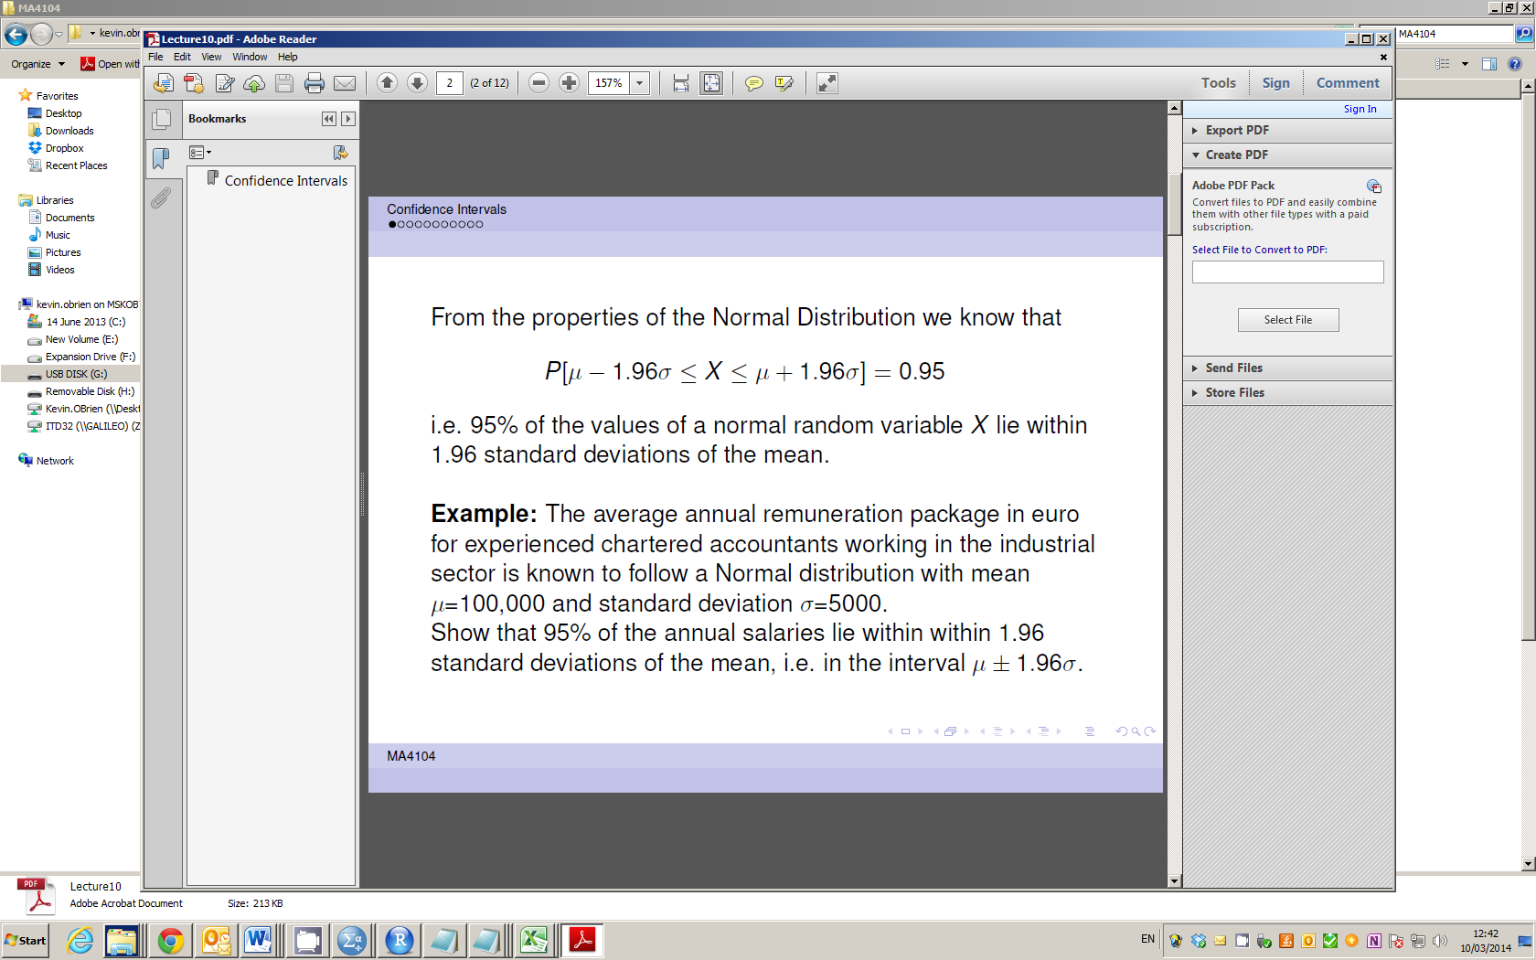
Confidence Intervals for the Mean

Slide 3
Confidence Intervals for the Mean

Slide 4
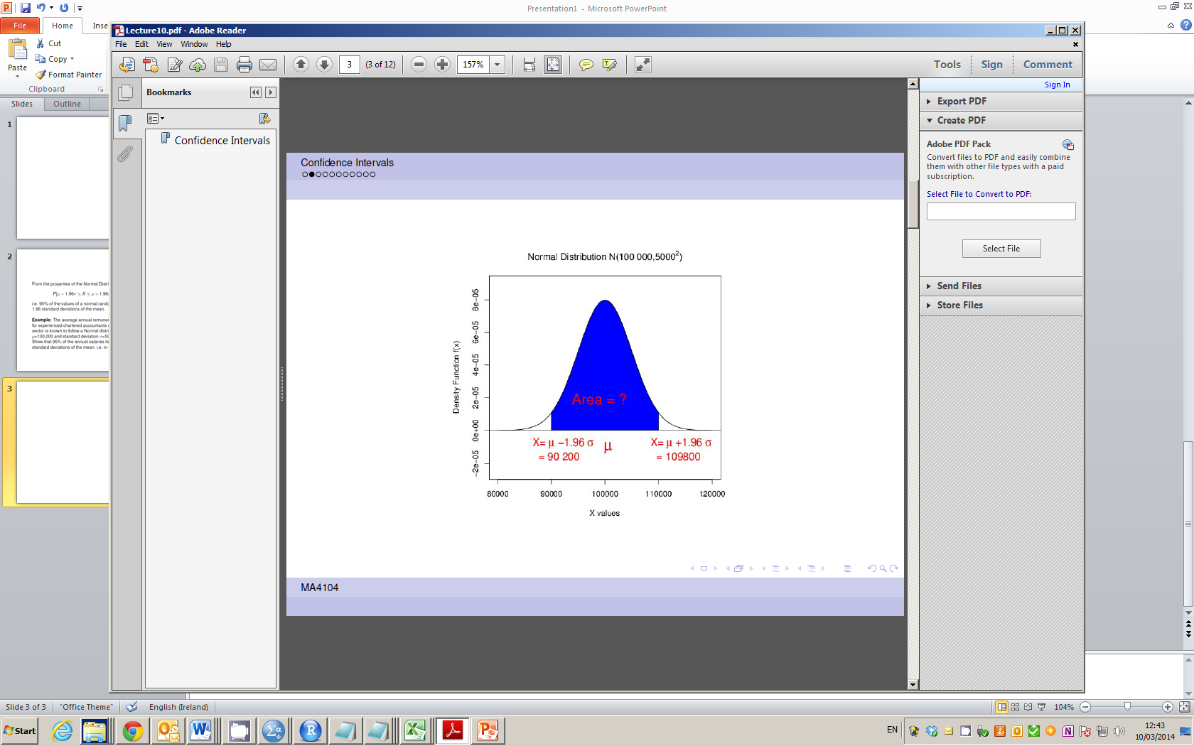
Confidence Intervals for the Mean

Slide 5
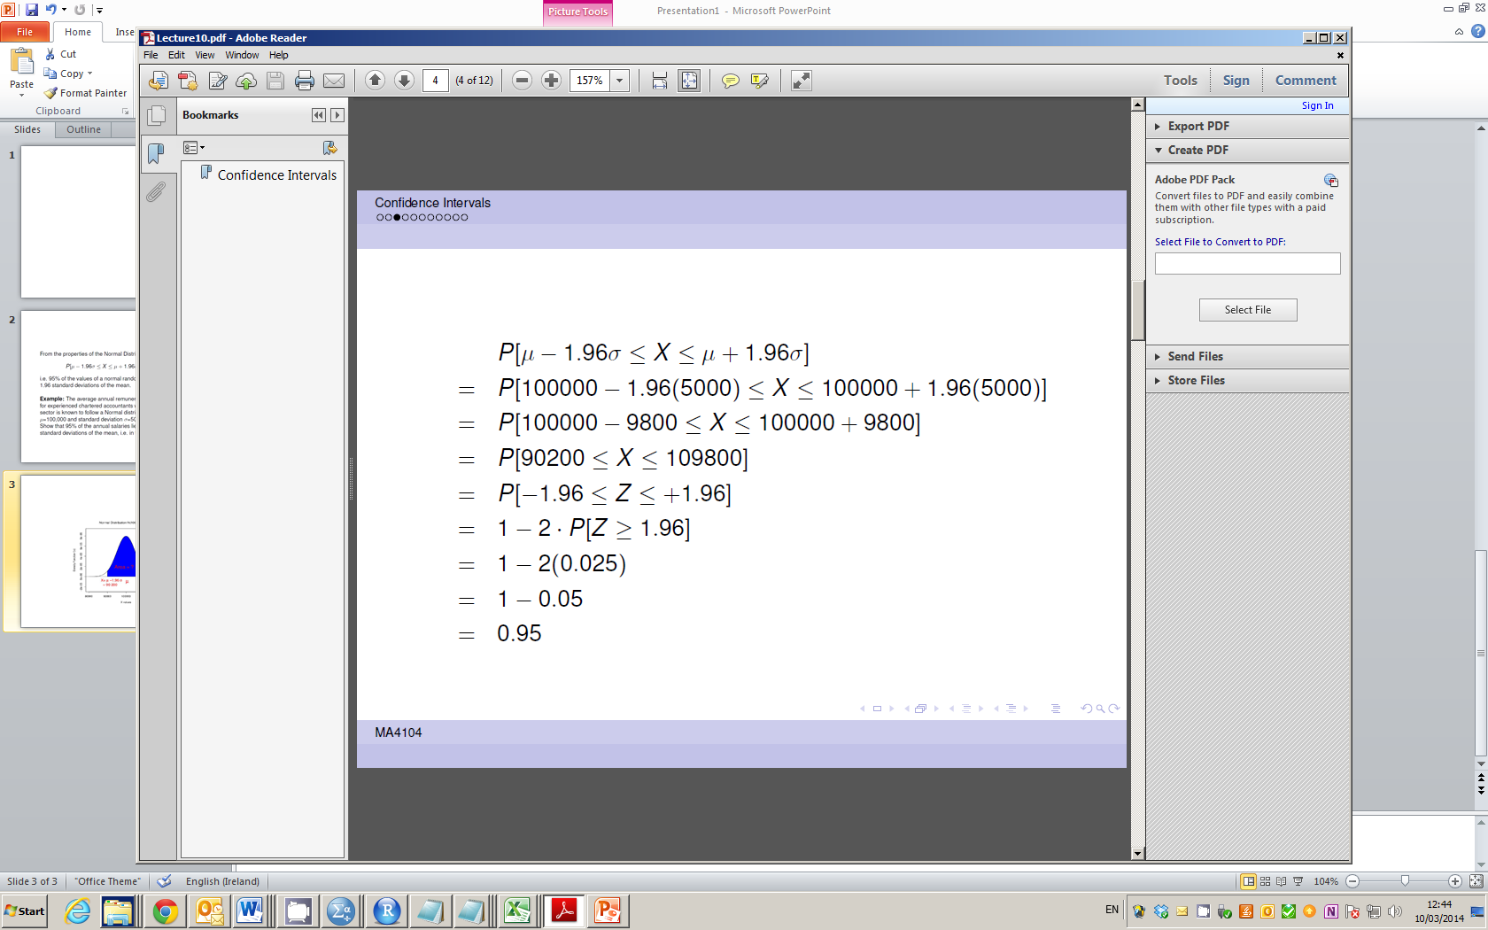
Confidence Intervals for the Mean

Slide 6
Confidence Intervals for the Mean

Slide 7
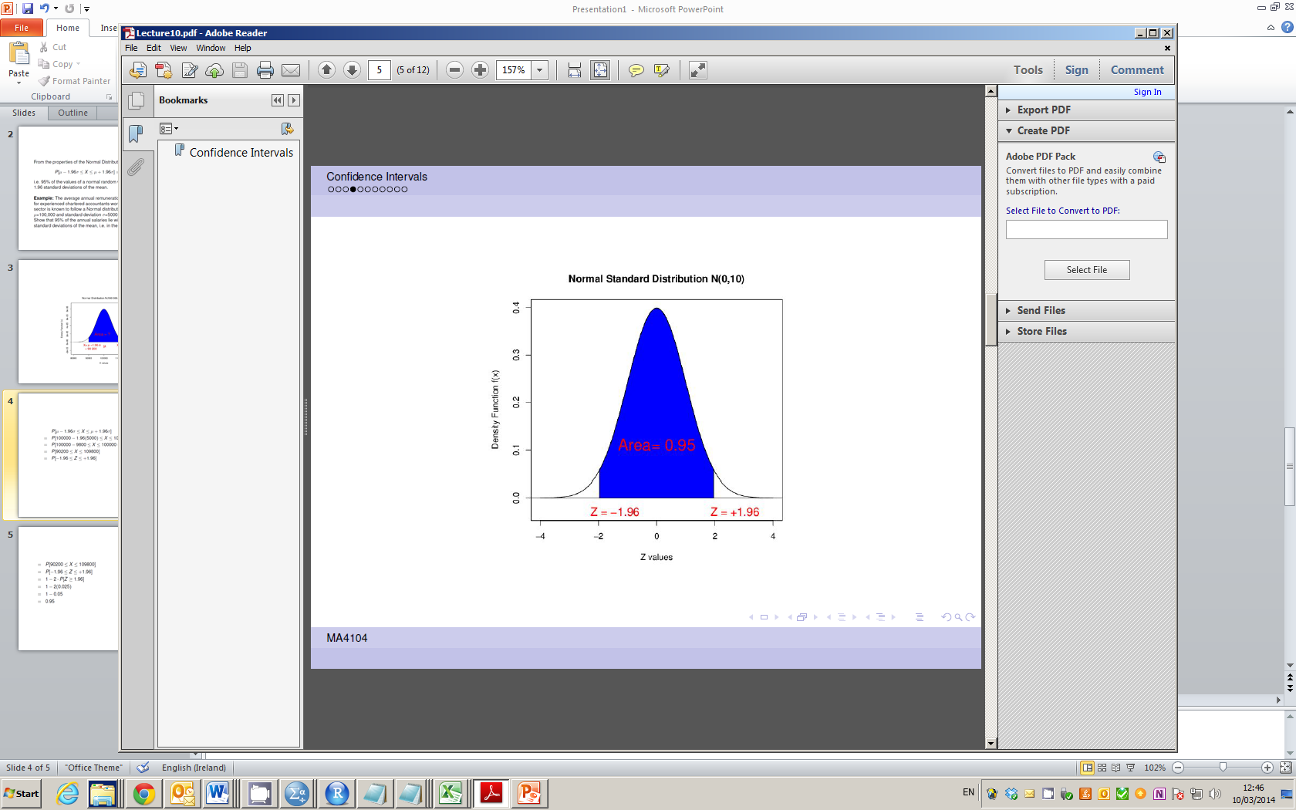
Confidence Intervals for the Mean

Slide 8
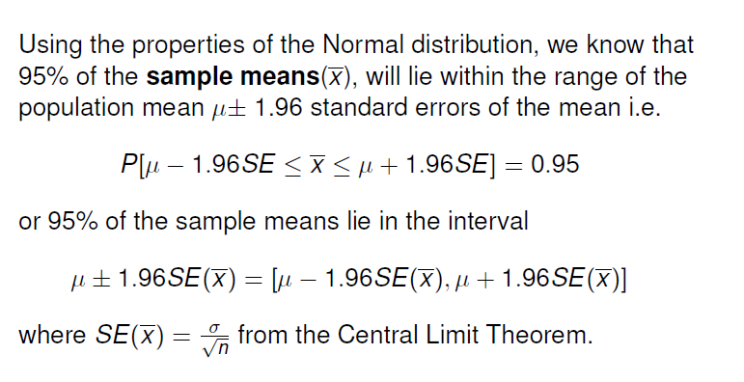
Confidence Intervals for the Mean

Slide 9
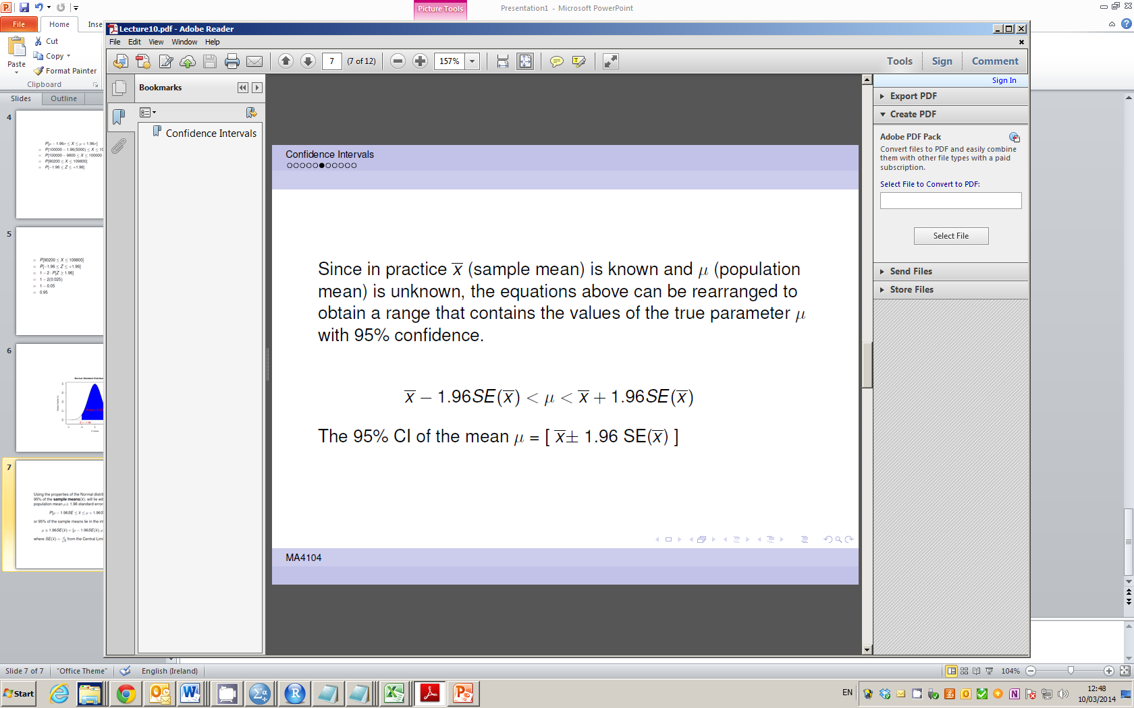
Confidence Intervals for the Mean

Slide 10
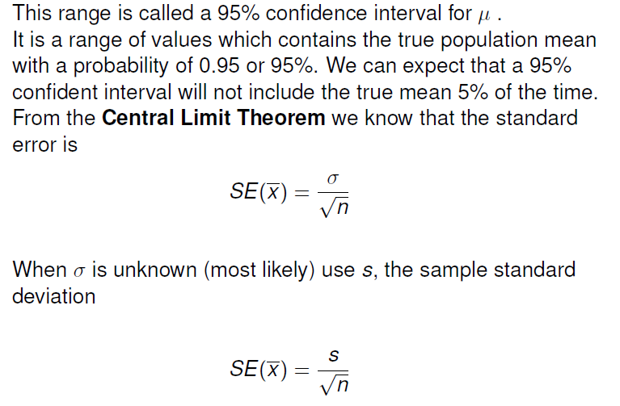
Confidence Intervals for the Mean

Slide 11
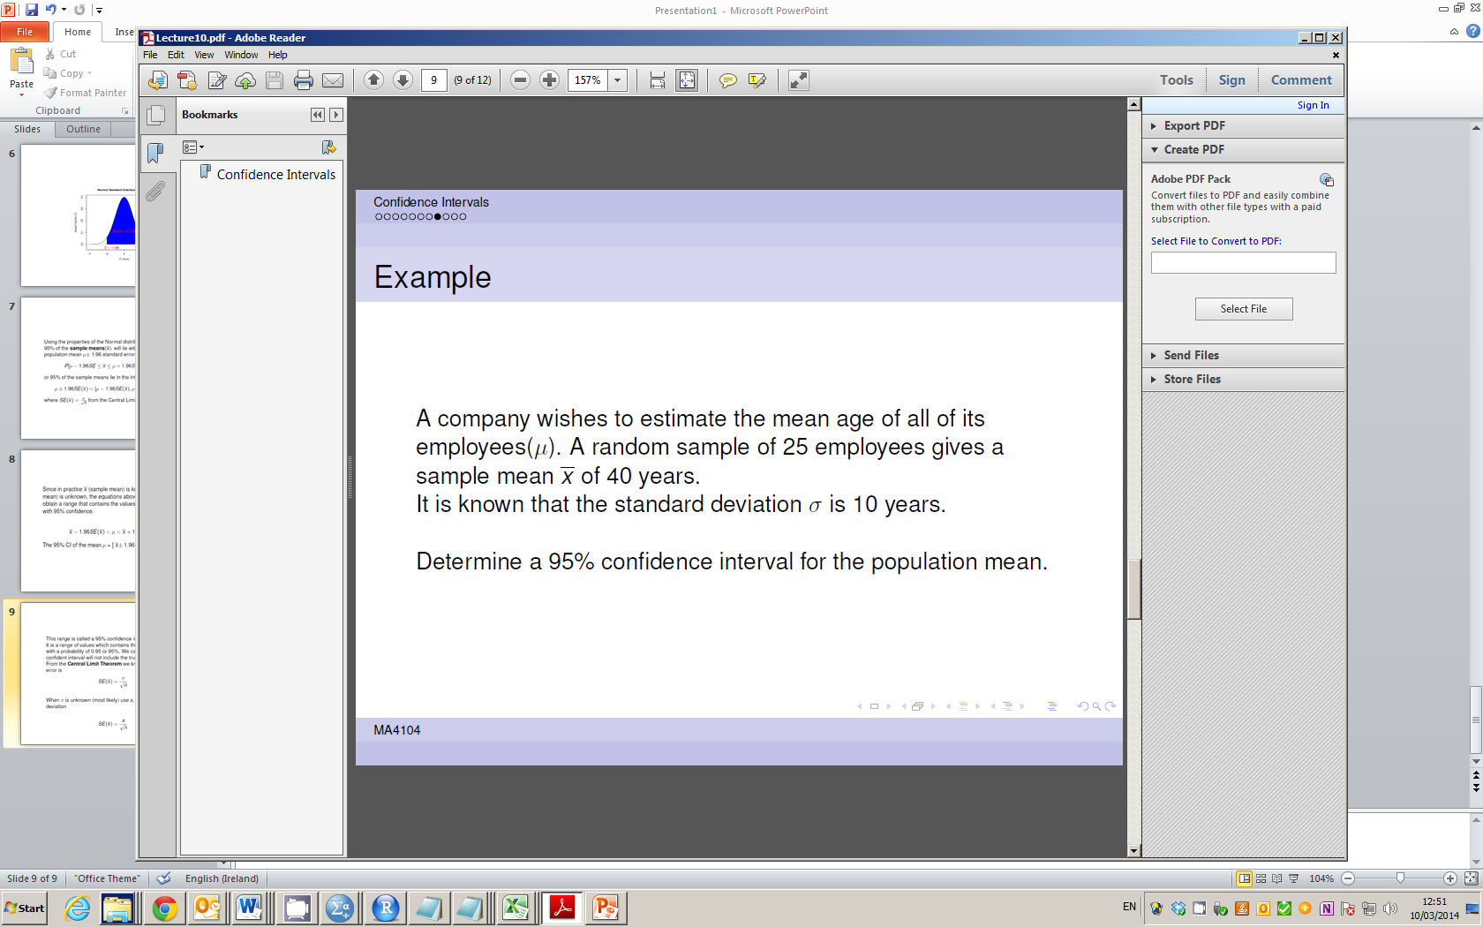
Confidence Intervals for the Mean

Slide 12
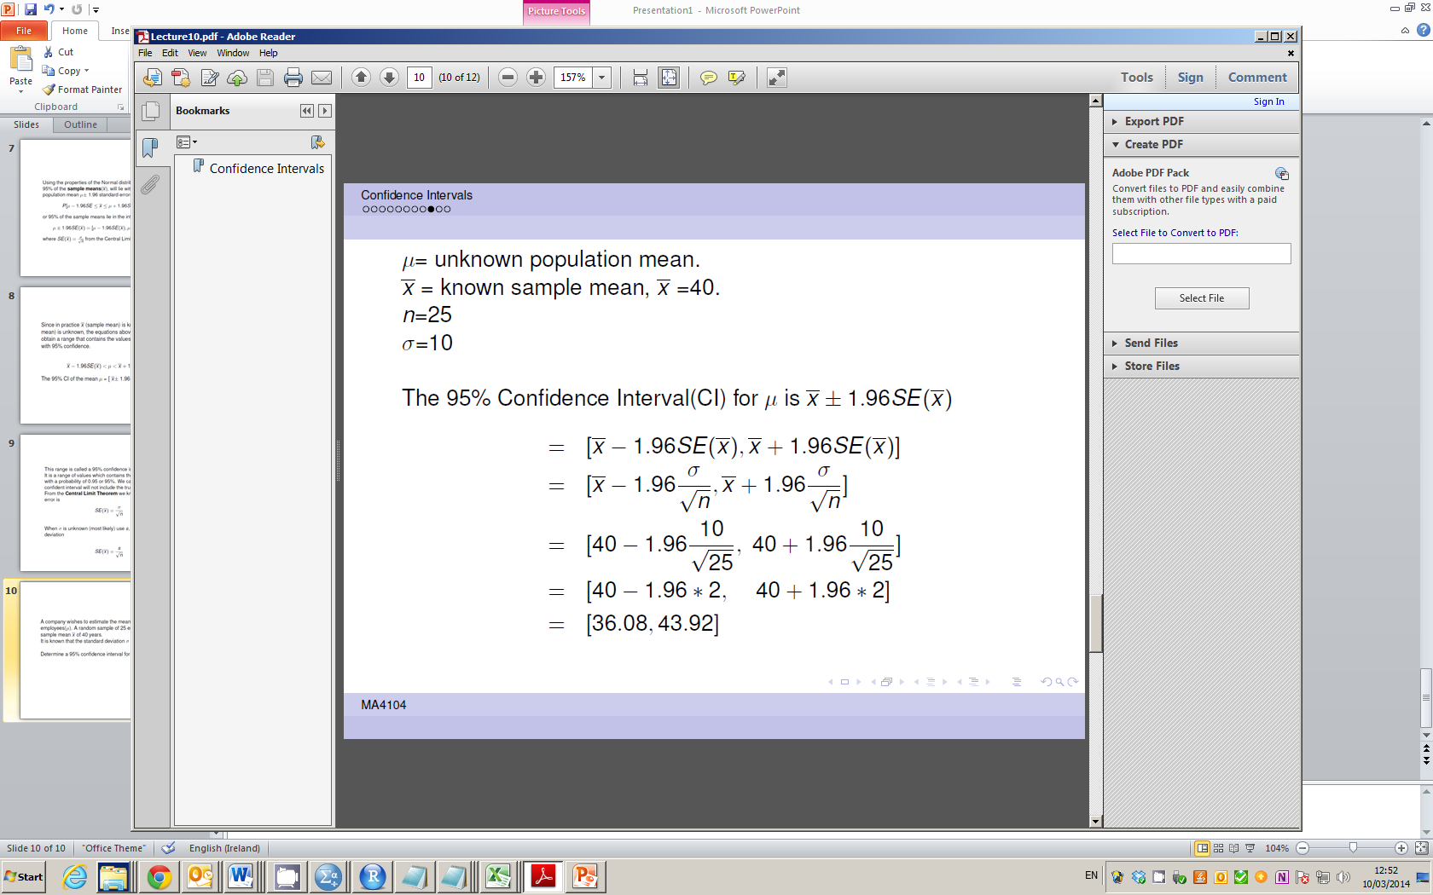
Confidence Intervals for the Mean

Slide 13
Confidence Intervals for the Mean

Slide 14
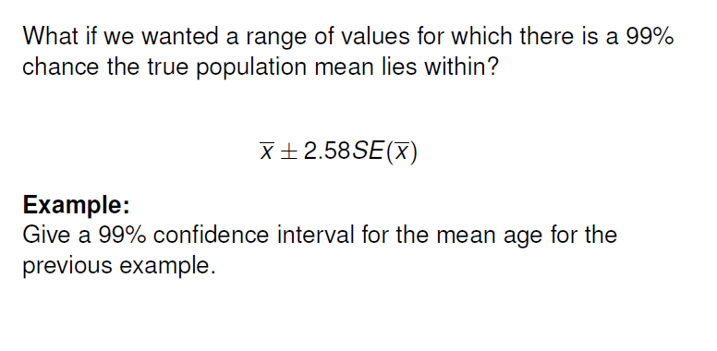
Confidence Intervals for the Mean

Slide 15
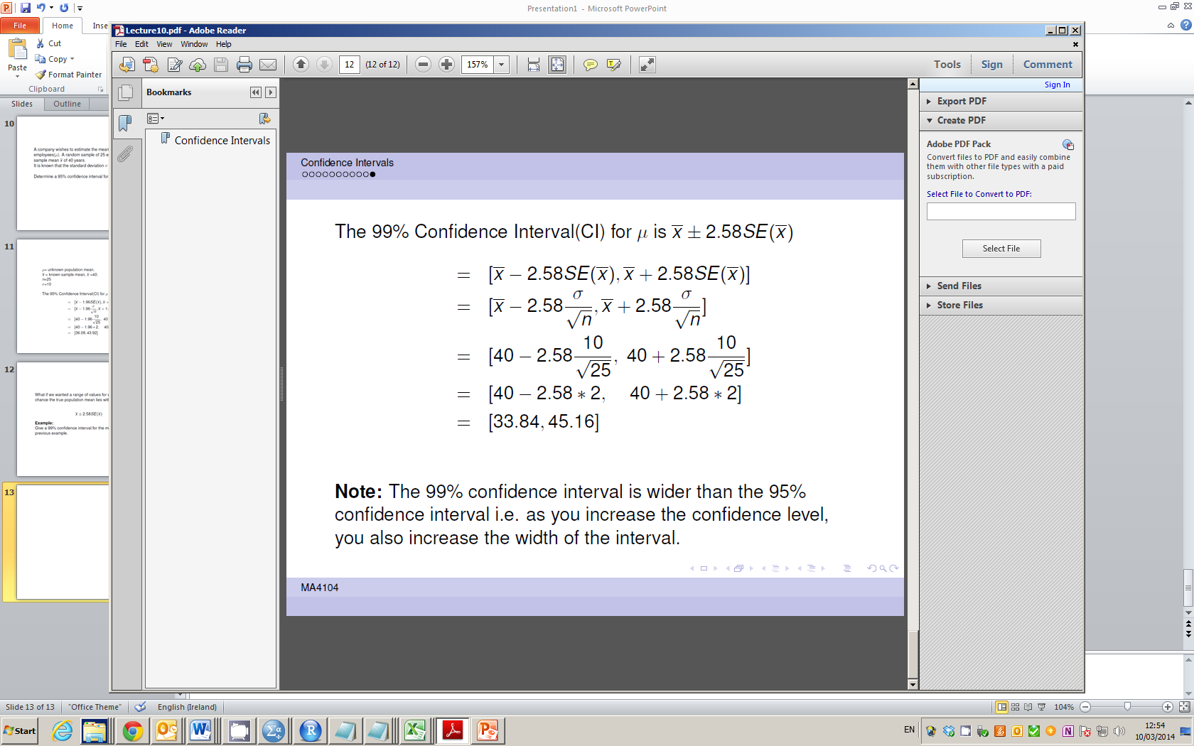
Confidence Intervals for the Mean

Slide 16
Confidence Intervals for the Mean

